Slide 1
CB 05 Analysis
Bruna Jermann
bgjermann@gmail.com
Notes:
Hello everyone, my name is Bruna and I spent the last few months studying and analyzing data on CB 05

Slide 2
About the Project
Goals
Learn about CBs
Learn Analytical Tools
Teach
Tools
Socrata – 311 Data
Excel – Pivot Tables, formulas, graphs
CartoDB
Notes:
This project was part of the Civic Innovation Fellowship program. Each of us choose a community board to work with.
The first part of the project was analyzing the CB website.
The second part was using Socrata open data to analyze 311 calls. I used excel to analyze the data and Cartodb to map the data

Slide 3
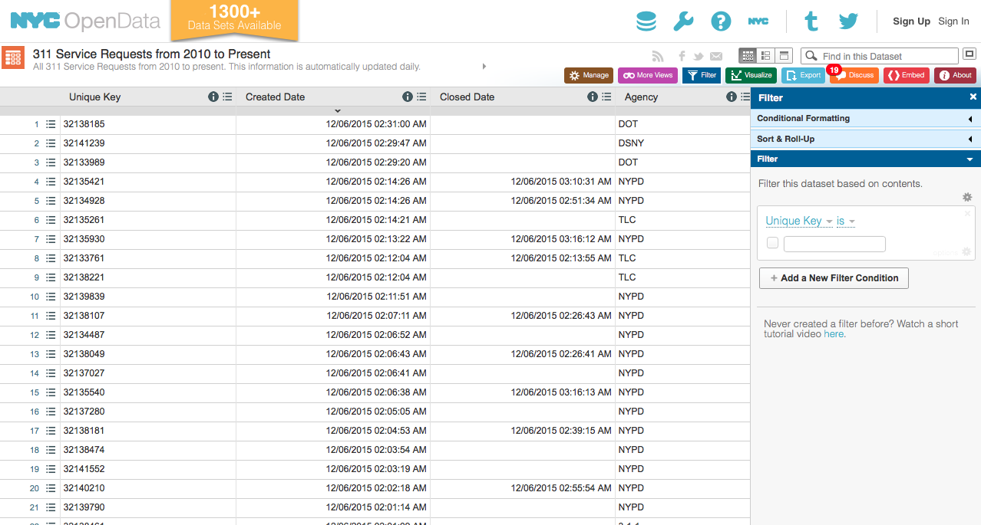

Slide 4
Agenda
About CB 5
Digital Footprint
Social Media
Data Analysis
Heat and Hot Water
Seasonal Analysis
Rodent Service Requests
Street Condition
Noise
Illegal Parking & Blocked Driveway
Notes:
This is the agenda for this presentation: in the first part I will talk about the website and social media presence
In the second part I will go through my data analysis process and findings

Slide 5
Part 1

Slide 6
Community District Digital Footprint
Positive
Calendar of Events and Announcements
Directory and Resources
Forms and Applications
Resolutions
Negative
Meeting Minutes
Social Media
Notes:
These are my remarks about the digital footprint. Overall, the website is visually very appealing with bright colors (I tried to used it as inspiration for these slides)
It’s a useful resource – it has updated announcements and calendar of events. The directory and resources are very useful listing housing, senior, and mental health services. It also has useful forms and applications explaining for to file liquor license petitions or even how to become a CB member. Areas of improvement: I could not find meeting minutes for the last year’s meetings and there is virtually no social media presence

Slide 7
Social Media Presence
Increase CB Awareness
Connect with Community
Advertise Events
Available 24/7
Information to Community
Increase Attendance in CB Executive Meetings
Notes:
CB 05 does not have Fb or Twitter. It makes the CB stand out in a negative way compared to other CBs since most of them have at least one or the other.
I listed some of the benefits of social media.

Slide 8
Part 2

Slide 9
Seasonal Analysis
Notes:
The first part of the data research was a seasonal analysis

Slide 10
Outlining Assumptions
Winter: Heating and Hot Water
Spring: Noise
Summer: Noise
Fall: Taxi Complaints
Notes:
I made simple assumptions about the effect of seasons over complaint types. I thought: ...

Slide 11
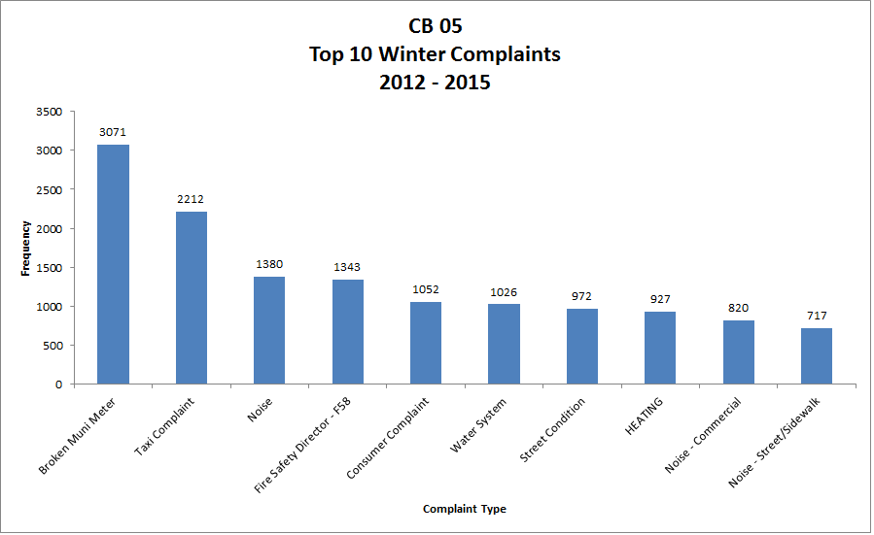
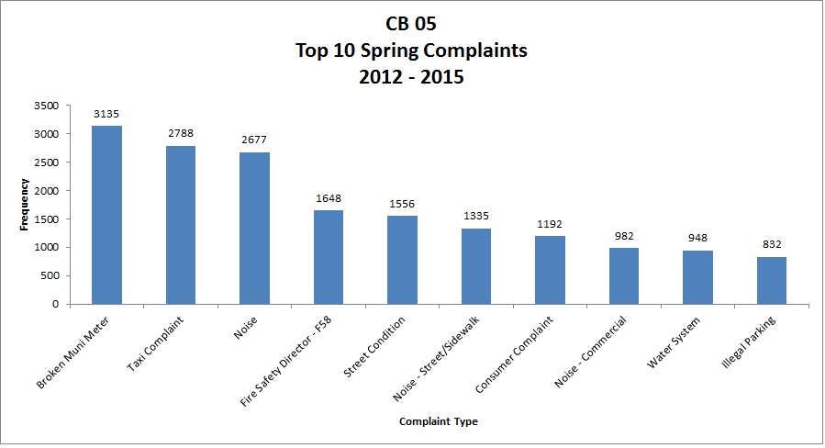
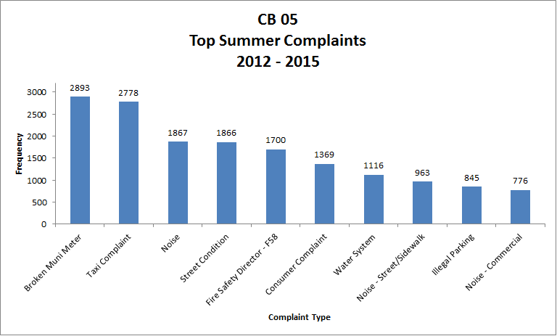
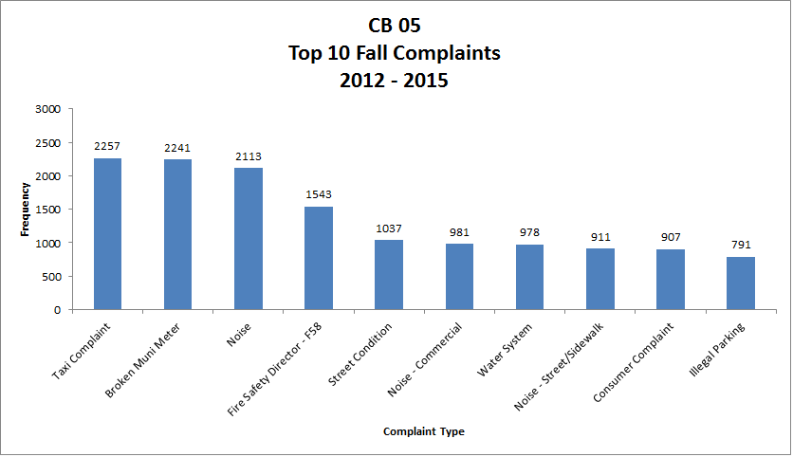
Source: Socrata, October 2015
Notes:
These graphs show that my assumptions were wrong. In fact, for CB 05, seasons played a role on complaint types, but the top 3 are consistent regardless of the season from 2012 to 2015 and they are Broken Meters, Taxi Complaints, and Noise
Heating complaints in Winter
More Noise complaints in Summer and Spring
Consistent Street condition complaints
Higher illegal parking only appears in Fall, Summer and Spring

Slide 12
Complaint Types by Season (2012 – 2015)
Source: Socrata, October 2015
Notes:
I made this graph too which is another way of comparing the complaint types. It’s nice cause you can see it as a general progression over the year
*Taxi Complaints go up on warmer months
* Noise is much higher on Spring
Fire safety stays almost the same
Heating only comes up on Winter and Illegal parking comes up in all seasons but Winter
It’s another way of looking at the same data

Slide 13
Seasonal Analysis
Total Winter | 22,647
Total Spring | 27,866
Total Summer | 27,094
Total Fall | 23,234
Total Complaints 2012 - 2015 | 100,841
Complaint Type | Complaints 2012 - 2015 | Percentage
Broken Meter | 11,340 | 11%
Taxi Complaint | 10,035 | 10%
Noise Complaint | 8,037 | 8%
Source: Socrata, October 2015
Notes:
There was a total of 100,841 complaints from 2012 to 2015, taking into account all complaint types (not just top 10)
The seasons with the highest average complaints are Spring and Summer.

Slide 14
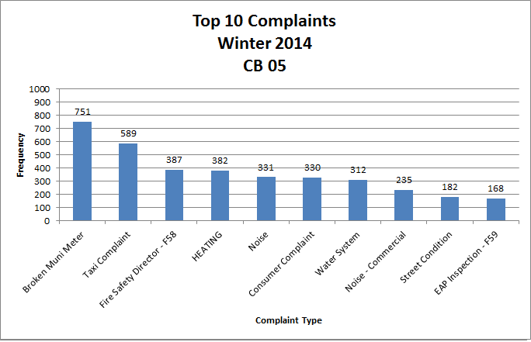
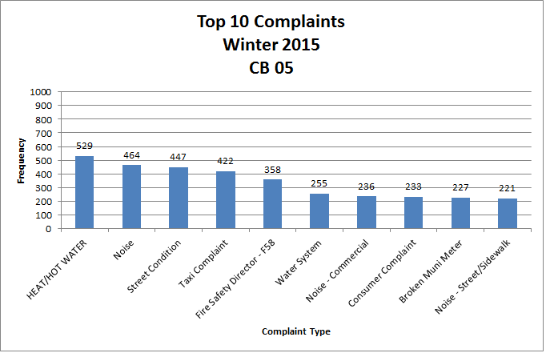
Predicting the next Winter...
Source: Socrata, October 2015
Notes:
Here we were asked to compare the Winter of 2014 and Winter of 2015.
We can actually notice here a huge drop in broken meter complaints from one year to the other, during the same months.

Slide 15
Source: Socrata, October 2015
Notes:
I made a graph showing complaints through the years to check my assumption, and indeed there was a big drop!
Something big must have happened – perhaps they were fixed? More research would be needed to say for sure

Slide 16
Frequency
Descriptors
Source: Socrata, October 2015
Notes:
Here I compared different descriptors among broken meter complaints. No receipt wins by far… then in 2014, then go down by a lot. In 2015 ‘no receipt’ is no longer the highest complaint descriptor

Slide 17
Heat and Hot Water Analysis

Slide 18
Heat and Hot Water Complaints
Density map by number of complaints
Map Link
Source: CartoDB, November 2015
Notes:
I created this map to get na idea of where the most heat and hot water complaints were located. The darker points represent addressed with the most recurrent complaints. The next map shows the hotspots more clearly

Slide 19
Heat and Hot Water Complaints
1691 BROADWAY
680 8 AVENUE
Addresses with the most heat and hot water complaints
15 EAST 31 STREET
18 WEST 16 STREET
10 EAST 16 STREET
Map Link
Source: CartoDB, November 2015
Notes:
I labelled the addresses with the highest concentrations of complaints. For example, 680 8 avenue. We can see the exact top 5 addresses in the next table

Slide 20
Top 5 Heat and Hot Water Complaint Sites
Complaint Address | Complaints 2012 - 2015 | Units | Stories | Date when built
680 8 AVENUE | 66 | 652 | 15 | 1920
1691 BROADWAY | 48 | 28 | 5 | 1925
139 WEST 28 STREET | 44 | 15 | 5 | 1901
18 WEST 16 STREET | 43 | 9 | 4 | 1920
15 EAST 31 STREET | 39 | 3 | 8 | 1925
Source: Streeteasy, November 2015
Notes:
Here we see the top 5 addresses with the most complaints from 2012 – 2015.
By putting the addresses on streeteasy we can see the units, stories, and dates when built.
All these buildings were built before 1925, which is something kind of rare in CB05, where most buildings are new.
* Notice the last two buildings. They have the most complaints relative to the number of units.

Slide 21
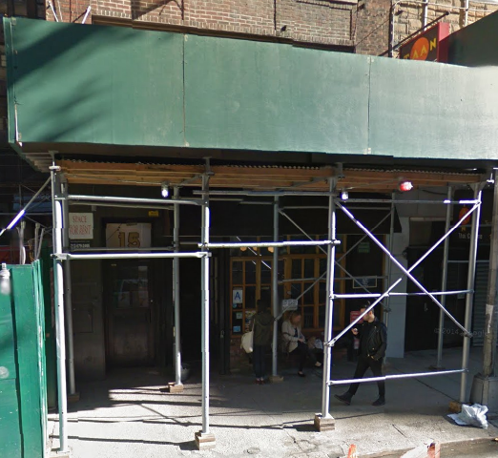
Recurrent Heat/Hot Water Complaints
Problem: Socrata Data > Only 2014 & 2015
190 (75%)
Recurrent
252
Locations
ENTIRE BUILDING | RESIDENTIAL BUILDING | 10016 | 15 EAST 31 STREET
Source: Socrata, November 2015
Notes:
In order to find the recurrent callers, I used pivot tables in excel to check which callers were calling every year.
The problem: socrata only gave me 2 years of data – the rest got lost?
This got in the way of my findings.. Cause the most recurrence I could measure was repeat callers for 2014-2015. Anyway, I based my numbers on that. There were 252 locations calling in 2014-2015. 75% of them called in both years.
That apartment is an example of that, it’s a good example of why this recurrence might happen – due to construction that might last more that might happen from 2014-2015

Slide 22
Rodent Service Requests

Slide 23
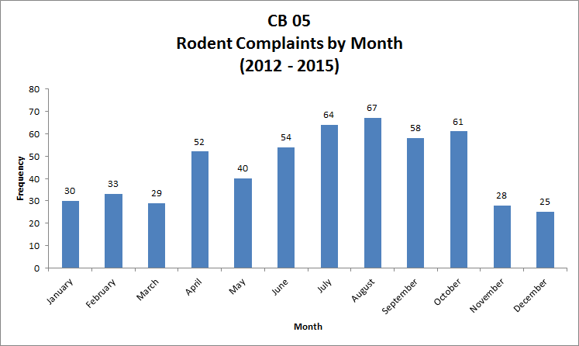
Source: Socrata, October 2015
Notes:
Here I graphed rodent complaints by month. We can see that there are more complaints around July and August.
Those are warmer months, and as we know, rats like to party outside with humans

Slide 24

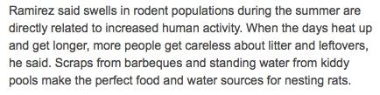

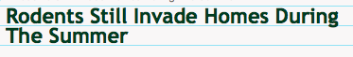
Oh Rats!
Map Sightings - MIT Project "You are Here"
Notes:
We were discussing why rodents are out in the summer.
I looked online for why and I found everything we were talking about – more people, more carelessness with food, not having to hide from cold. But also, it seems like rats reproduce on warmer months.. Iuc
If we have time, there is a map that shows mouse sightings over the year, it basically shows there are less sightings over winter

Slide 25
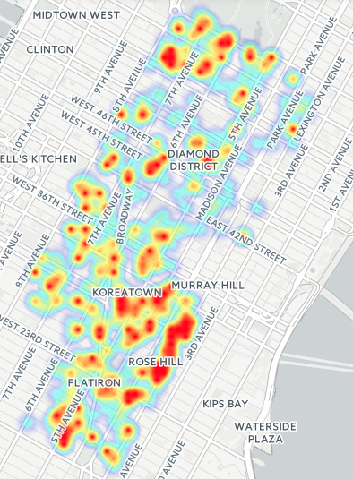
Rodent Service Requests
Heat map by concentration of rodent complaints
Map Link
Source: Socrata, November 2015
Notes:
These are the areas with the most rodent complaints.
Koreatown and close to Central Park which make sense, in my opinion

Slide 26
Rodent Complaints
WEST 55 STREET
Addresses with the most rodent complaints
WEST 43 STREET
EAST 28 STREET
EAST 26 STREET
Map Link
Source: CartoDB, November 2015
Notes:
The addresses with top complaints. The one with the most complaints by far is East 26 Street

Slide 27
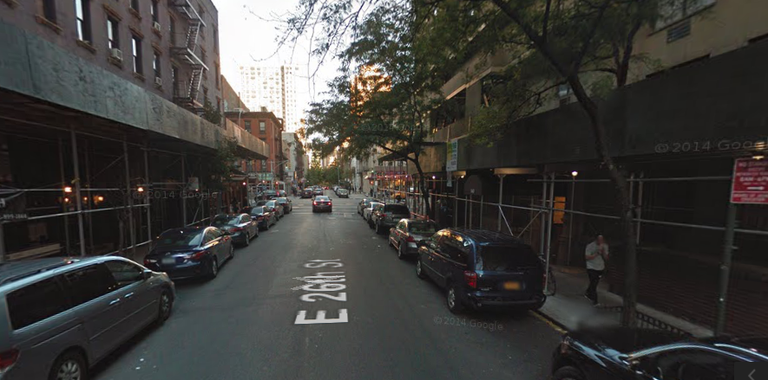
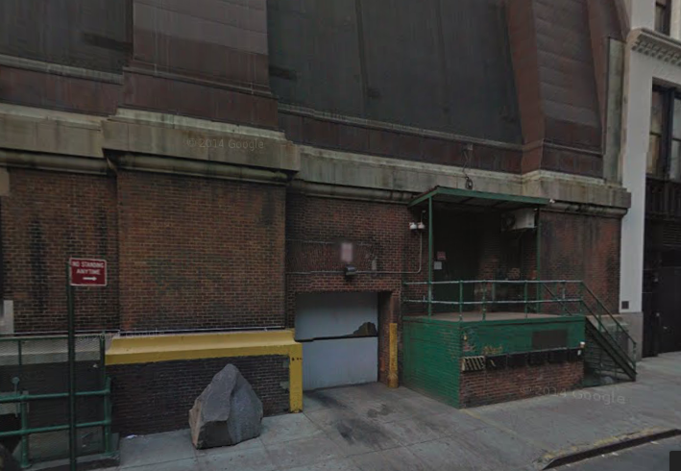
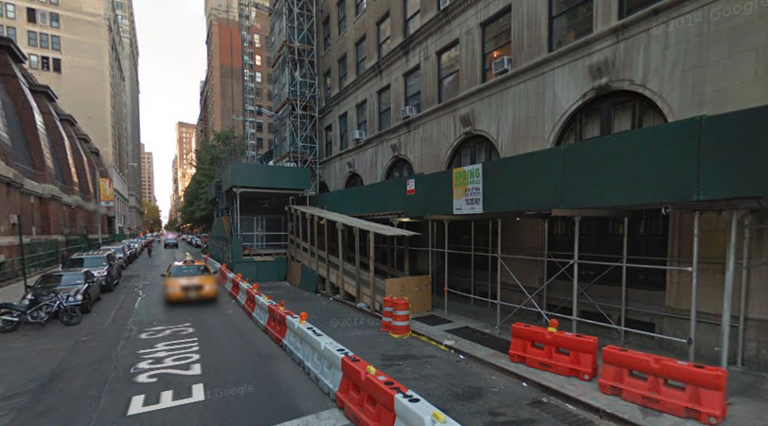
EAST 26 STREET
Between Park Ave. and Lexington Ave.
Source: Google Maps, November 2015
Notes:
This is the top area with rodent complaints and it’s pretty easy to understand way. There are over 5 construction sites happening in just a few blocks. There are also warehouses and restaurants

Slide 28
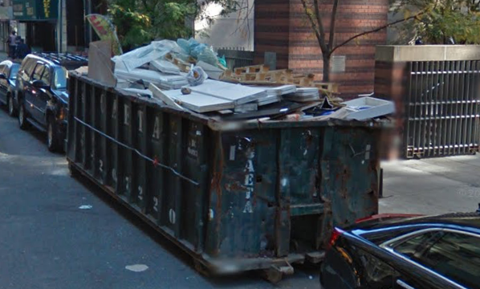
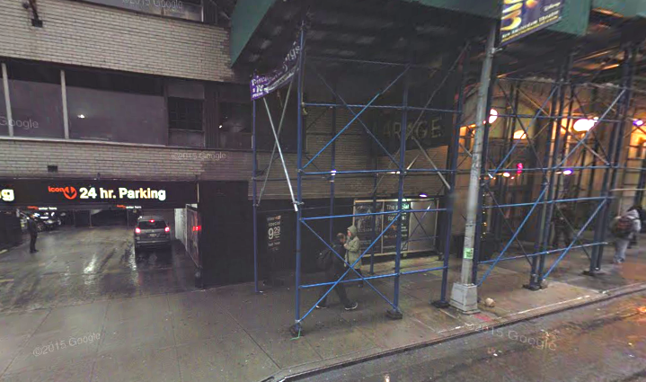
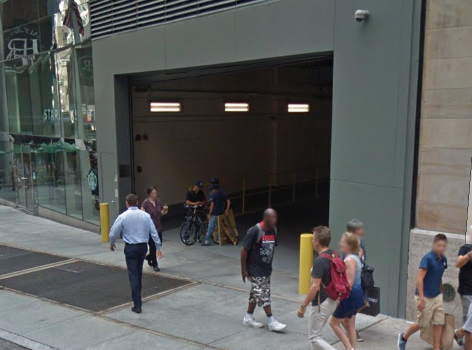
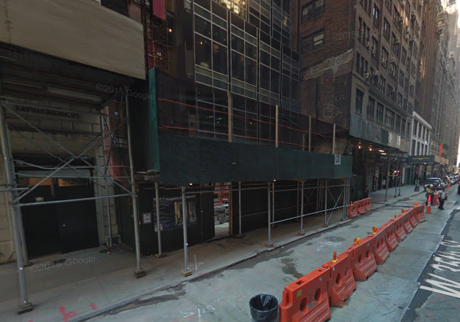
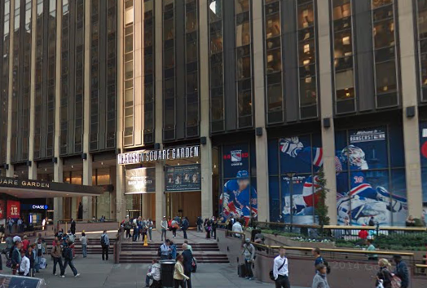
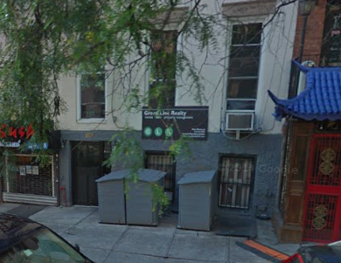
Top Locations - Google Maps Screen Shots
Source: Google Maps, November 2015
Notes:
I looked through other top complaint locations and I found common factors. Construction sites, parking lots, Garbage containers, and even Madison Square Garden
ADD addresses

Slide 29
Street Condition

Slide 30
Notes:
This graph gives the frequency of descriptors across different years. We notice something close to an overlap to most categories, showing the number of complaints have been fairly constant through the years.
One thing obviously stands out: pothole complaints. They grew up considerably from 2012-2014 then a lot also from 2014-2015

Slide 31
Discovering Data Problems…
Descritor | Frequency | Year
Pothole | - | 2012
Pothole | - | 2013
Pothole | 660 | 2014
Pothole | 1499 | 2015
Source: Socrata, November 2015
Notes:
Then I looked at my data and realized: there is not even one single complaint in 2012 and 2013.
Obviously this graph does not look right --- Socrata problem?
It seems like there is a big jump from 2014 to 2015, but could it be that some of the data from 2014 got lost too?

Slide 32
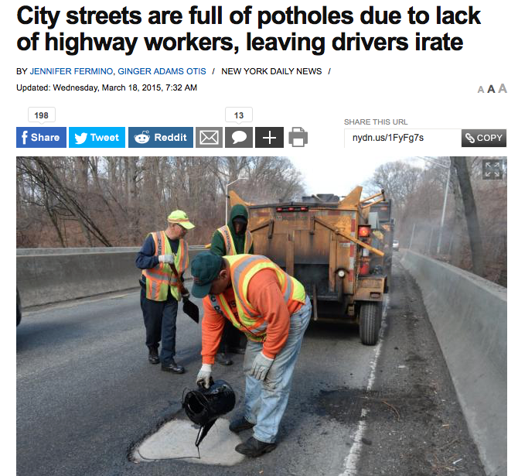
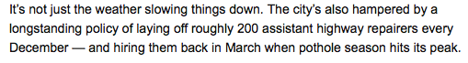
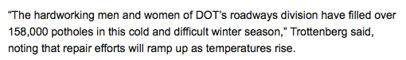
Source: New York Daily News, November 2015
Notes:
In fact, Potholes are a cyclical problem in NYC…every winter potholes are formed due to fissures on the ground caused by low temperatures.
They can only be fixed when the weather warms up, during the Spring, which can be dangerous and troublesome.

Slide 33
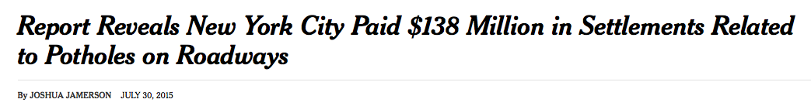
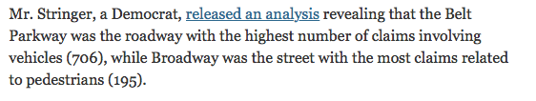
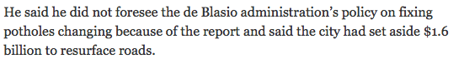
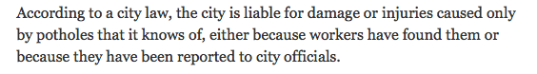
Source: New York Times, November 2015
Notes:
An article in the NYC was highlighting the amount of money spent by the city in settlements related to potholes causing injury and damages.
According to this article, the city is only liable for damage or injuries caused by potholes that it knows of ---either because workers have found them or because they have been reported. This shows how important of a tool 311 can be

Slide 34
Noise

Slide 35
Source: Socrata, November 2015
Notes:
Midtown is a very noisy area. A lot of construction...A lot going on, late hours. The warmer months have more noise, as expected, since people’s spend time outside.

Slide 36
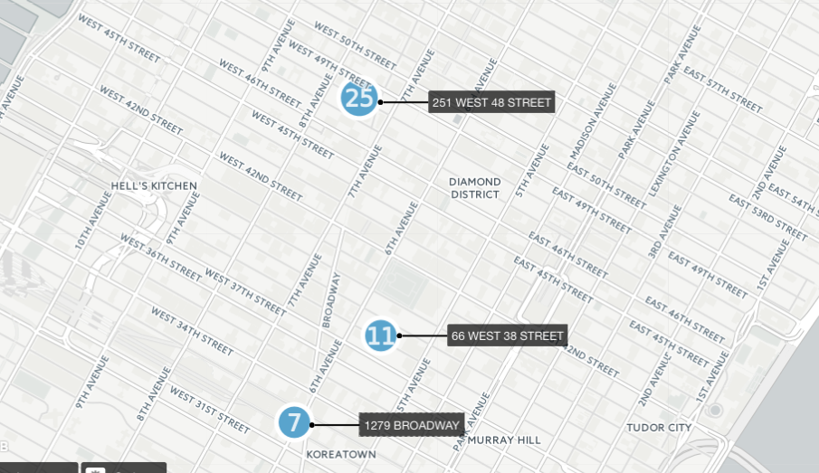
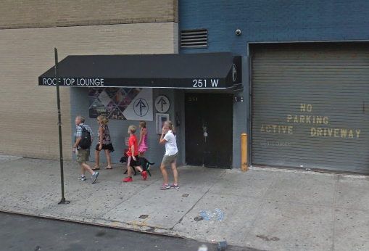
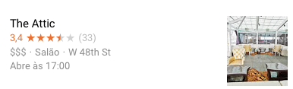
Top 3
“Loud Music/Party” Locations, 2015
Map Link
Source: CartoDB, November 2015
Notes:
These are the top 3 loud music / party complaint locations.
The first is this club called the attic. This kind of information can be very useful for CBs since it can help them assess if they should keep their liquor license

Slide 37
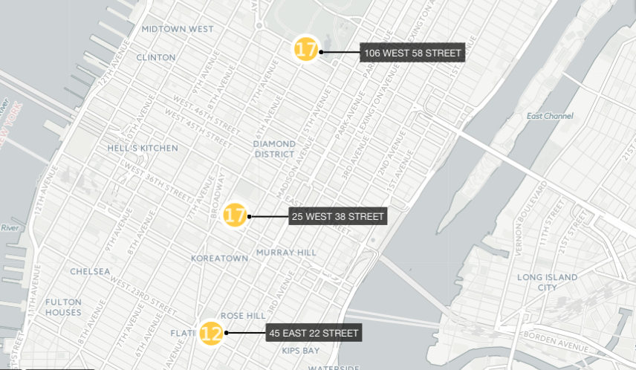
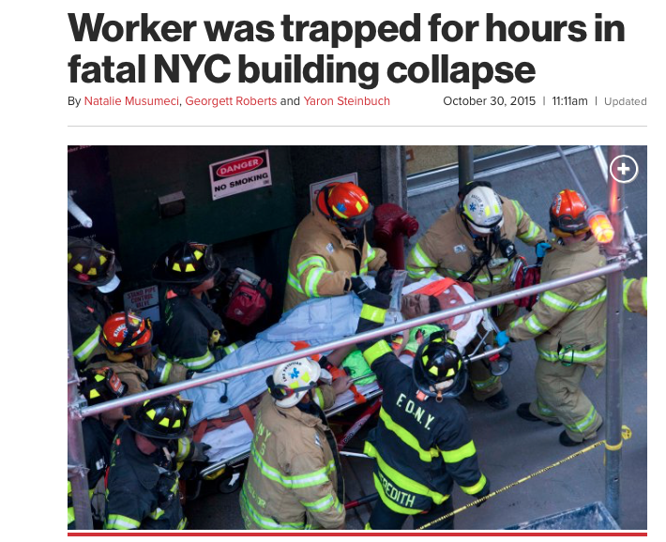
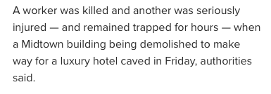
Top 3
Construction Noise
Locations, 2015
Map Link
Sources: CartoDB and NY Post, November 2015
Notes:
These are the top 3 locations for construction noise. The location in 25 west 38 was actually on the news for a horrible accident. It has nothing to do with this, but it turns out to be one of the most complained construction areas in CB 05

Slide 38
Illegal Parking and Blocked Driveway

Slide 39
Source: Socrata, November 2015
Notes:
There are many blocked parkways all around the year, but they are higher on warmer months and beginning of Fall

Slide 40
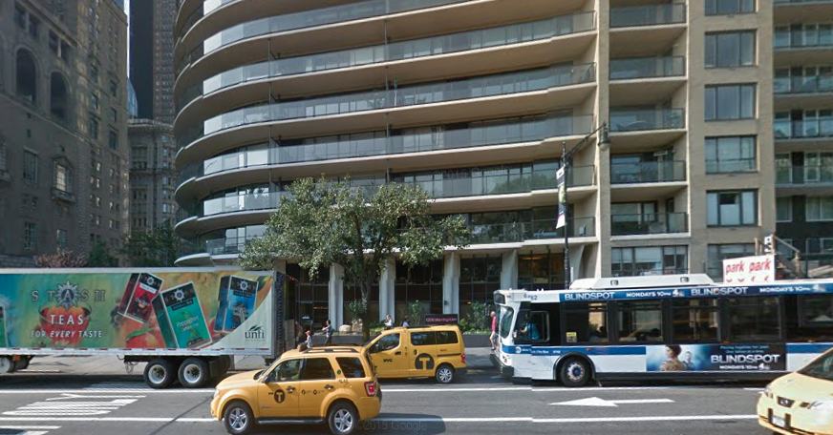
Recurrent Blocked Driveways 2010 - 2015
468
Blocked Pkways
# of Years | # of Addresses | % of Total
6 | 1 | 0.2%
5 | 5 | 1.1%
4 | 12 | 2.6%
3 | 30 | 6.4%
2 | 81 | 17.3%
1 | 339 | 72.4%
Blocked Driveway | No Access | Street/Sidewalk | 10019 | 200 CENTRAL PARK SOUTH
Source: Socrata and Google Maps November 2015
Notes:
I did the same process from the beginning but now using 6 years worth of data. I looked for complaint areas that would show up in 2010-2015 . The most it could appear is 6 times, since there are only 6 years being analyzed. There was one location that apparently has been receiving complaints every year.
Most of the locations, as we can see in the table, received complaints only in one year

Slide 41
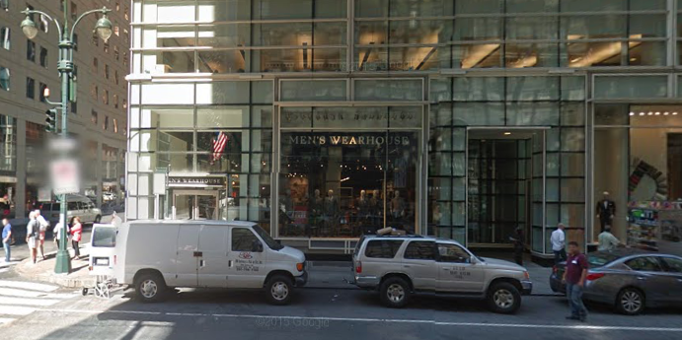
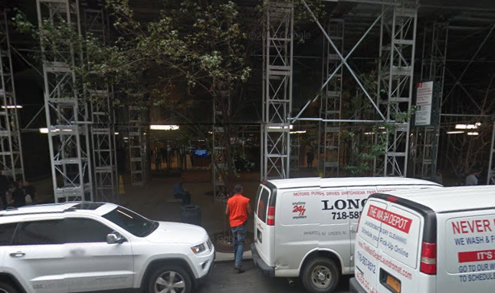
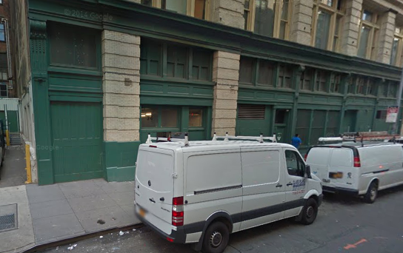
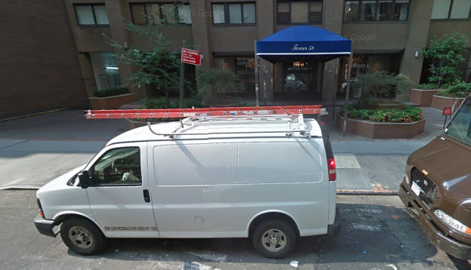
CB 05’s Most Blocked Driveways
Notes:
These are some of the top complained blocked parkway areas.
ADD ADDRESSES and closer driveway show

Slide 42
Thank you!

